Slide 1
How can we achieve constant temperature in our system?
FINAL PROJECT PREPARATION
SUGGESTIONS?
Notes:
What hardware do we need?
What software?

Slide 2
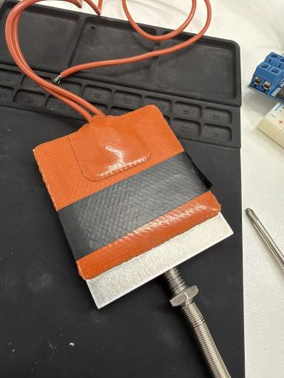
Closed-Loop Temperature Control
FINAL PROJECT PREPARATION
Building a PI controller that holds a heating pad on target — with a thermocouple or PT100 sensor for feedback.
Lab-prep guide • Read before the hands-on labs
Notes:
What is our goal in this project: We want to control the temperature of something (in our case, an aluminium slab) and keep it constant. What is the best way to do that?
For this we need control theory.

Slide 3
Open Loop vs. Closed Loop
01
WHY CONTROL THEORY
Control theory makes a system track a target automatically — feeding actual behavior back to correct for disturbances we can't predict (heat loss, changing load).
OPEN LOOP
CLOSED LOOP (what we build)
Set an input and hope — no measurement feeds back.
Measure the output, compute an error, drive the controller.
Setpoint
Controller
Effector
Setpoint
+/-
Controller
Effector
Sensor
Sensor
sensor feedback
No feedback path — drift goes unnoticed.
CHECK Why can't an open-loop heater guarantee stable temperature if someone opens a window nearby?
Notes:
Examples for open loop systems:regular simple heaters Examples for closed loop: air conditioning closed loop system, oven, AFM, cruise control in car, drone height, servo motor

Slide 4
The PID Controller
02
THREE TERMS FROM ONE ERROR
e(t) = setpoint − measured u(t) = Kp·e(t) + Ki·∫e(τ)dτ + Kd·de/dt
P — Proportional
I — Integral
D — Derivative
Reacts to the CURRENT error.
Reacts to ACCUMULATED past error.
Reacts to the RATE OF CHANGE.
Bigger error → bigger correction. Alone it always leaves a small steady-state offset — as error shrinks, so does the push.
Keeps pushing while any error remains, so it erases steady-state offset — but too much causes overshoot and windup.
Damps fast swings before they overshoot. Great on quick systems, but it amplifies sensor noise.
CHECK Why is the derivative term noisy on a slow system?
Notes:
U(t) – 0-100%. This is the power output. Integral is from start of experiment or using a window. This should be limited by us so as not to be above maximum
In a slow system the derivative will be small, smaller than the effect of the noise (which can change rapidly)

Slide 5
Choosing Between P, PI, PD, or PID
03
MATCH THE CONTROLLER TO THE SYSTEM
Simple systems where some steady-state offset is acceptable.
P
Eliminate steady-state error when the process is slow enough that D-noise hurts more than it helps.
PI
◄ WE USE THIS
Fast systems (e.g. motor position) where damping overshoot beats erasing a small offset.
PD
Need zero offset AND fast, well-damped response — when D can be tamed (e.g. filtered).
PID
Thermal systems respond slowly, so a derivative term mostly amplifies sensor noise without adding real benefit — PI is the sweet spot for the heater.

Slide 6
Tuning PID Parameters: Simulation
04
A MANUAL, OBSERVATIONAL METHOD
1
Start with P only
SIGNS TO WATCH FOR
Set Ki = Kd = 0. Raise Kp until temperature nears setpoint quickly — stop before it oscillates persistently.
Too much overshoot / ringing
2
Add I in small steps
→ reduce Kp or Ki
Removes the steady-state offset P leaves behind. Watch for slow oscillation or growing overshoot — that means Ki is too high.
Sluggish, never reaches setpoint
→ increase Kp, or add/raise Ki
3
Add D only if needed
Not for this slow thermal system. It damps leftover oscillation but reacts to noise.
Slow oscillation that grows
→ Ki is too high; reduce it
CHECK If temperature overshoots then oscillates with shrinking amplitude before settling, which term do you adjust first — and which way?
Notes:
With simulation

Slide 7
Our Project
04
HANDS ON EXPERIMENT
1
Use Power output to heat a heating sheet
Questions
Use PWM duty cycles for fine control of power output
What parameters do we need?
2
Measure temperature using sensor
PP,PI,PD,PID?
Use ThermoCouple or PT-100 to measure the temperature – feedback for closed loop
Power range
→ Do we need to limit the Integral value and U(t)?
3
Keep temperature stable
Experiment with different parameters
Slow oscillation that grows - TK
→ Ki is too high; reduce it
CHECK If temperature overshoots then oscillates with shrinking amplitude before settling, which term do you adjust first — and which way?
Notes:
With simulation

Slide 8
Choosing Between P, PI, PD, or PID
03
MATCH THE CONTROLLER TO THE SYSTEM
Simple systems where some steady-state offset is acceptable.
P
Eliminate steady-state error when the process is slow enough that D-noise hurts more than it helps.
PI
◄ WE USE THIS
Fast systems (e.g. motor position) where damping overshoot beats erasing a small offset.
PD
Need zero offset AND fast, well-damped response — when D can be tamed (e.g. filtered).
PID
Thermal systems respond slowly, so a derivative term mostly amplifies sensor noise without adding real benefit — PI is the sweet spot for the heater.

Slide 9
Why This Matters for the Final Project
06
A TEXTBOOK CLOSED-LOOP PROBLEM
Hold a heating pad at a chosen temperature despite heat loss to the air — using the TC or PT100 for feedback. Everything above is exactly what you implement, run, and tune by hand on real hardware.
SETPOINT
SENSOR FEEDBACK
CONTROLLER
ACTUATOR
Target temperature you choose
TC or PT100 reading
Your PI implementation
MOSFET switching power via PWM
The payoff: run the same loop against both sensors and compare how a thermocouple and a PT100 behave on identical hardware.

Slide 10
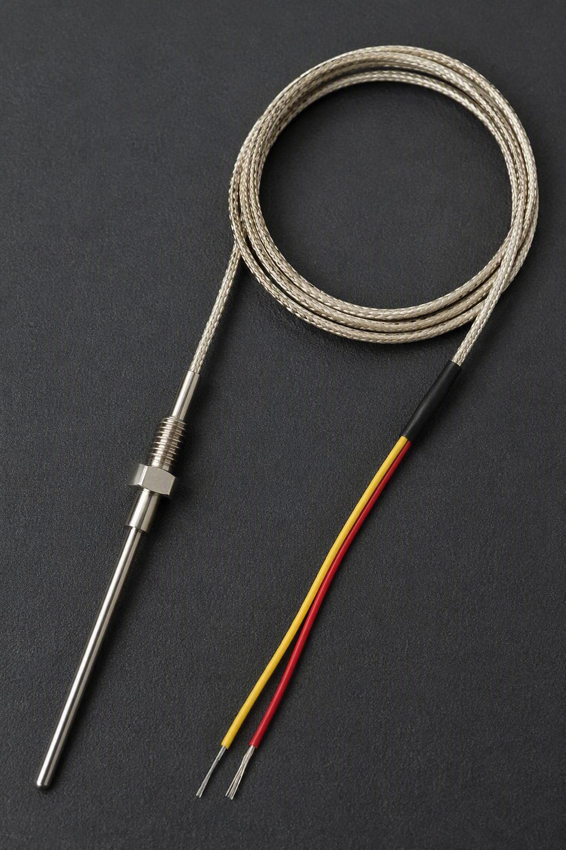
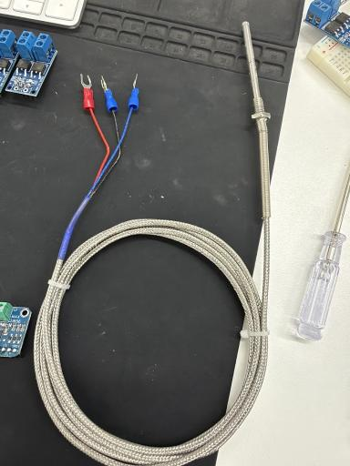
Thermocouple vs. PT100 Sensors
08
SAME WIRING, DIFFERENT PHYSICS
THERMOCOUPLE
K-type · MAX31856
PT100 RTD
MAX31865
PRINCIPLE
PRINCIPLE
Seebeck voltage at a two-metal junction; the amp compensates the cold junction.
Platinum resistance rises with temperature — 100 Ω at 0 °C.
WIRING
WIRING
2 wires (K-type).
3-wire, which cancels lead-wire resistance.
RESPONSE
RESPONSE
Faster, and more stable when touched or disturbed.
Slower, and more fault-prone when disturbed.
CHECK Why does the MAX31856 need the cold-junction temperature while the MAX31865 doesn't?

Slide 11
Implementing PID in Software
05
DISCRETE TIME ON A MICROCONTROLLER
A microcontroller works in discrete steps: approximate the integral as a running sum and the derivative as a difference between samples.
PI control cycle · every dt seconds
Anti-windup
error = setpoint − measured_temp
integral = integral + error * dt
integral = clamp(integral, min, max)
output = Kp*error + Ki*integral
output = clamp(output, 0, 100)
apply(output) # drive the heater
If the integral grows unbounded while output is saturated (heater at 100%), it takes ages to unwind — causing big overshoot. Clamp the integral term.
Fixed sample interval
A consistent Δt (not "however long the loop took") keeps the I and D terms mathematically consistent between runs.
CHECK What happens to overshoot if we remove the anti-windup clamp on a system that sits at 100% duty for a long time before reaching setpoint?

Slide 12
SPI Communication
07
A SYNCHRONOUS MASTER–SLAVE BUS
Both amplifiers (MAX31856 for the TC, MAX31865 for the PT100) talk to the Arduino over SPI — four signals share the bus.
SCK
MOSI
MISO / SDO
CS
Serial Clock
Master Out, Slave In
Master In, Slave Out
Chip Select
Arduino generates the clock that paces every bit.
Data from Arduino to the sensor module.
Data from the sensor back to Arduino.
Pulled low to address one slave; each device needs its own CS.
Pin 13
Pin 11
Pin 12
D4
On the Uno / Grove Beginner Kit, SCK/MOSI/MISO are fixed at pins 13/11/12 — only CS is freely assignable. We use D4 for both sensors, one at a time.
CHECK To read a TC and a PT100 at the same time on one Arduino, which SPI pins would be shared and which separate?

Slide 13
Pins on the Sensor Transducers
09
READING THE BREAKOUT-BOARD LABELS
MAX31856
MAX31865
Thermocouple amplifier
PT100 / RTD amplifier
VIN / GND
power in
VIN / 3V3
power in
SDO
MISO — data to Arduino
SDO
MISO — data to Arduino
SCK
serial clock
CS
chip select
CS
chip select
CLK
SCK — serial clock
SDI
MOSI — data from Arduino
SDI
MOSI — data from Arduino
DRDY
data-ready interrupt (optional)
RDY
ready interrupt + 2/3/4-wire jumper
Both expose the same four SPI signals (named slightly differently) plus power and an optional ready pin — so they swap into the same wiring with minimal changes.
CHECK Instead of polling a fault flag every cycle, both chips expose a DRDY/RDY pin. What kind of Arduino input reacts to it without constant polling?

Slide 14
Controlling Power: MOSFET & PWM
10
SWITCHING BIG CURRENT WITH A TINY PIN
Arduino pins supply only a few milliamps. PWM drives the gate of a MOSFET — a voltage-controlled switch — which switches the heater's much larger current on and off.
DUTY CYCLE = fraction of time ON
drive the heater pin
25%
~25% power
duty = controller_output
# 0–100 from the PI loop
pwm = map(duty,0,100,0,255)
analogWrite(HEATER_PIN, pwm)
50%
~50% power
100%
~100% power
Thermal mass averages the fast pulses into smooth, adjustable heating — 50% delivers roughly half the power of 100%.
CHECK If the PWM were slow enough that the pad fully heated and cooled within one on/off pulse, would this averaging approximation still hold?

Slide 15
The Heating Pad
11
THE PLANT WE'RE CONTROLLING
P = I²R
Current through the resistive element converts electrical power directly to heat.
Resistive silicone element — Passing current heats it directly.
Aluminum plate — Spreads heat evenly and adds thermal mass.
Silicone heating pad bonded to an aluminum plate
Thermal mass smooths PWM — It averages the duty-cycle pulses, so no visible temperature ripple.

Slide 16
The Power Supply
12
TWO SOURCES, VERY DIFFERENT CAPABILITY
BENCH POWER SUPPLY
ARDUINO USB PORT
≤24 V
≤3 A
~72 W
5 V
~500 mA
~2.5 W
VOLTAGE
CURRENT
MAX POWER
VOLTAGE
CURRENT
MAX POWER
Powers: The heating pad, via the MOSFET switch. We run the heater circuit at 12 V.
Powers: The Arduino board and logic-level sensor amplifiers only.
TRY IT Set the bench supply to 12 V and measure the Arduino's 5V pin. Confirm the two are electrically separate — grounds stay common, but power comes from two very different sources.
CHECK Why is powering the pad from the Arduino's 5V USB supply a bad idea, even at low duty cycle?

Slide 17
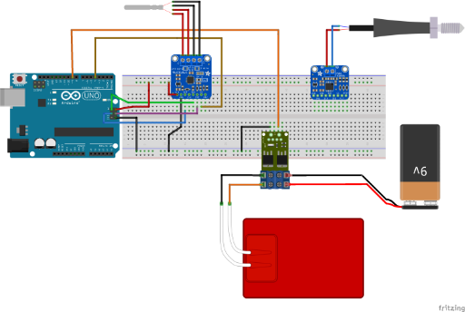
Full Wiring Diagram
13
HOW IT ALL CONNECTS
THE CIRCUIT
Arduino Uno
Runs the PI loop; SPI on 13/11/12, CS on D4.
Sensor amplifiers
MAX31856 (TC) & MAX31865 (PT100) on the bus.
MOSFET module
Switches heater power from the PWM gate signal.
Heating pad
The plant — driven by the external supply.

Slide 18
Key Takeaways
BEFORE THE LABS
Closed loop, not open
PI is our controller
Feedback lets the controller notice and correct drift; open loop can't.
P for speed, I to erase offset — D is skipped on a slow, noisy thermal plant.
Tune by observation
Clamp the integral
Raise Kp, then add Ki; watch overshoot, sluggishness, and growing oscillation.
Anti-windup and a fixed Δt keep the software loop stable and consistent.
Know the hardware
Compare two sensors
SPI sensors (TC / PT100), a MOSFET + PWM actuator, and a separate 12 V supply.
Run the same loop against the thermocouple and the PT100 and contrast them.

